Slide 1
Interdomain Resource Orchestration: An Network-Application Integration Approach
Qiao Xiang, Xiamen University
Joint work with many collaborators
11/29/2021

Slide 2

A Quick Look at Internet: Past
1957: USSR launched Sputnik; US DoD formed Advanced Research Projects Agency (ARPA)
1961: First paper by Len Kleinrock on packet switching theory
1964: Paul Baran from RAND on design of packet switching networks
1965-1968: ARPANET plan,
BBN awarded Packet Switch contract to build Interface Message Processors (IMPs)
1970: ALOHAnet, the first packet radio network, developed by Norman Abramson, Univ of Hawaii, becomed operational
1973: Bob Kahn posed the Internet problem---how to connect ARPANET, packet radio network, and satellite network
design should survive failures
keep the network simple
internetworking:
need a network to connect networks

Slide 3
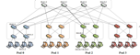
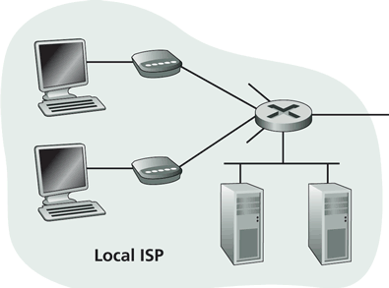
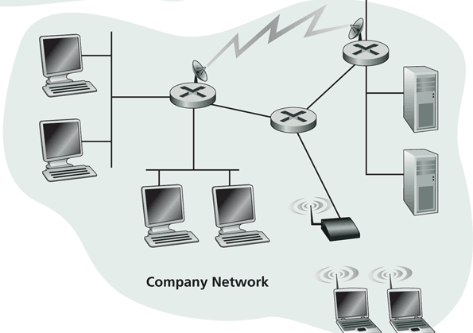
A Quick Look at Internet: Present
Residential access
Cable, Fiber, DSL, Wireless
ISP
Backbone ISP
ISP
The Internet is a network of networks
Each individually administrated network is called an Autonomous System (AS)
data center
Campus access, e.g.,
Ethernet
Wireless

Slide 4
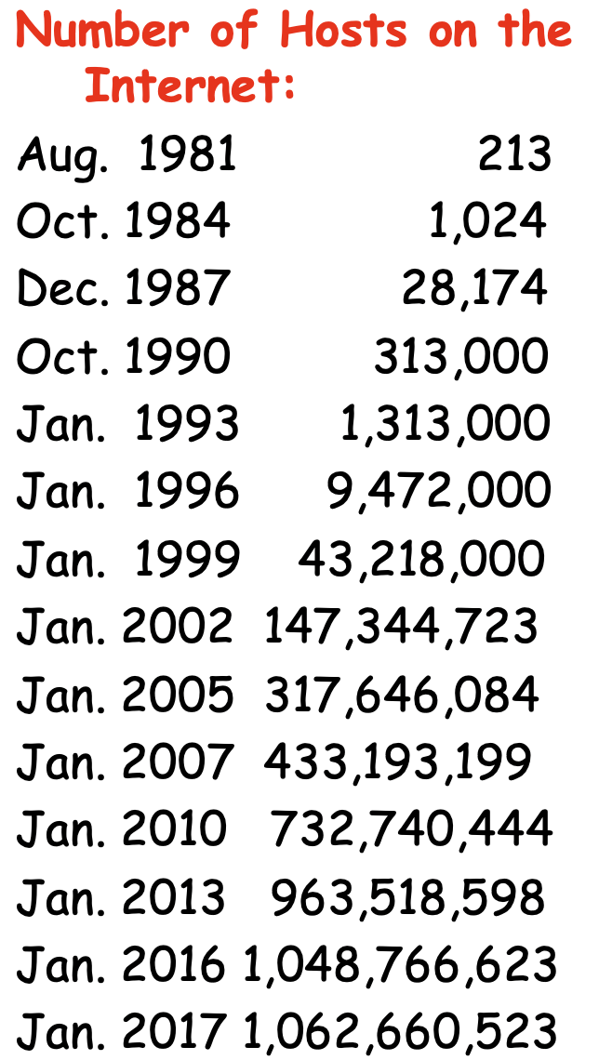
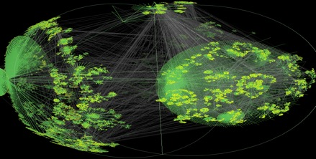
A Quick Look at Internet: Present
CAIDA router
level view
http://ftp.isc.org/www/survey/reports/current/

Slide 5
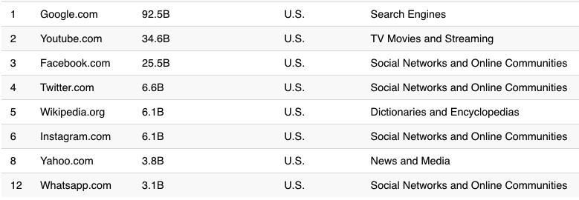


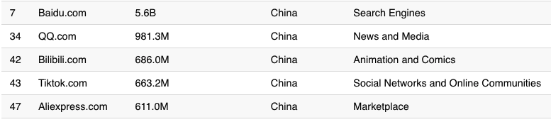
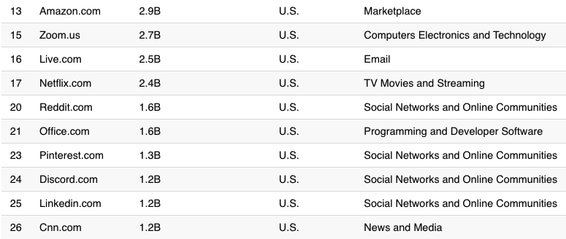
A Quick Look at Internet: Present
https://www.visualcapitalist.com/wp-content/uploads/2021/01/Country-With-the-Most-Websites.html
Notes:
http://www.comscore.com/Insights/Press_Releases/2013/8/comScore_Media_Metrix_Ranks_Top_50_U.S._Web_Properties_for_July_2013

Slide 6
Driving Question:
If you are asked to design an Internet clean-slate,
what would you do?

Slide 7


Issues of Current Network Architecture
To application, network is a general-purpose, best-effort black box
To network, different applications are indifferent
s₁
d₁
s₂
d₂

Slide 8
Our Approach: Network-Application Integration
Network: open the black box to provide applications more information to better utilize / control network resources
Application: provide network semantics / instructions to better support application requirements

Slide 9
Roadmap
How (in)efficient current network interfaces can be?
BoxOpt: optimizing in the dark [AAAI-19] [TON-21]

Slide 10
A Fairy Tale Question
Ask for a wish. I can tell you if I can give it to you.
What is the BEST wish he can give me?

Slide 11
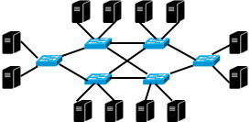
Fairy Tale in Network
Network resource reservation systems (e.g., RSVP)
bring substantial benefits of providing predictable network resources for modern distributed applications (e.g., Hadoop and Spark) .
provide a simple reservation interface for users to submit requests for reserving a specific amount of bandwidth, and return either success or failure.
Request bandwidths for flows. I can tell you if you can get them.
What are the optimal bandwidths I can get from network?

Slide 12
Previous Proposals
Require the network to provide network resource information to the user
Expose the private information of network (e.g., topology, policy and bandwidth capacity) to user, resulting in security vulnerability
Require the user to provide her objective for choosing resources
Expose the private information of user (e.g., internal orchestration policy) to network, allowing the network to violate the network neutrality

Slide 13
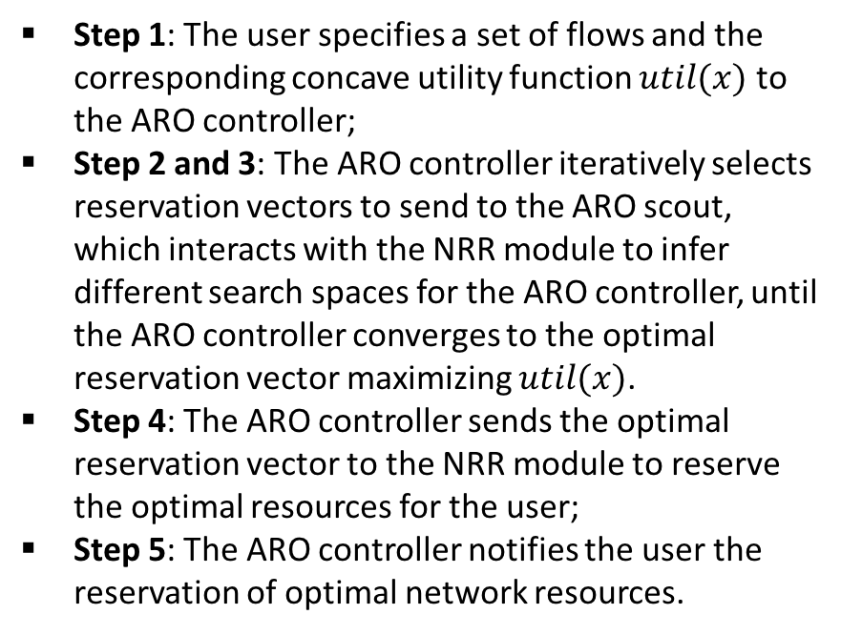
Our Solution: BoxOpt
How can this be done?
A learning system that automatically learns the optimal resource reservations without exchanging any private information between the network and the user.
Step 1: The user specifies a set of flows and the corresponding concave utility function $util(x)$ to the ARO controller;
Step 2 and 3: The ARO controller iteratively selects reservation vectors to send to the ARO scout, which interacts with the NRR module to infer different search spaces for the ARO controller, until the ARO controller converges to the optimal reservation vector maximizing $util(x)$.
Step 4: The ARO controller sends the optimal reservation vector to the NRR module to reserve the optimal resources for the user;
Step 5: The ARO controller notifies the user the reservation of optimal network resources.
Step 1
User
ARO Controller
Step 5
Step 2
Inferred
Search Space
Step 4
Automatic
Reservation Optimization
Module
Success
Reservation
Vector
Optimal
Reservation
Vector
Step 3
ARO Scout
Reservation
Vector
Success /
Failure
Network
Network Resource
Reservation Module
Architecture and workflow of BoxOpt

Slide 14
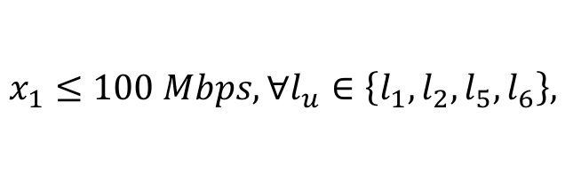
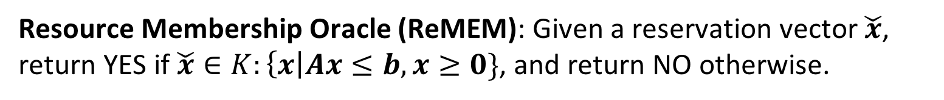
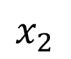
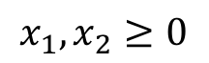
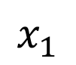

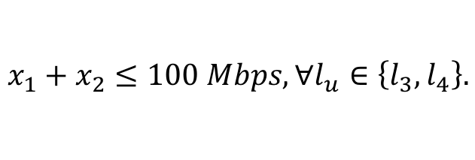
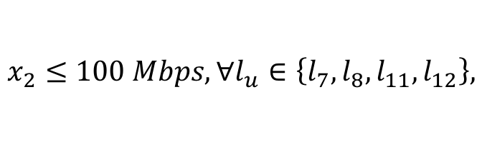
Simple Reservation Interface as a Resource Membership Oracle
The NRR module uses linear inequalities to model the bandwidth availability and sharing information of flows.
Resource Membership Oracle (ReMEM): Given a reservation vector $\check{x}$, return YES if $\check{x}∈K:\left\{x\right|Ax≤b, x≥0\}$, and return NO otherwise.
Bandwidth feasible region $K$
$$x_{1}≤100 Mbps, ∀l_{u}∈\left\{l_{1},l_{2},l_{5},l_{6}\right\},$$
$$x_{1}$$
100
$$x_{2}≤100 Mbps, ∀l_{u}∈\left\{l_{7},l_{8},l_{11},l_{12}\right\},$$
$$x_{1}+x_{2}≤100 Mbps, ∀l_{u}∈\left\{l_{3},l_{4}\right\}.$$
$$x_{2}$$
$$x_{1}, x_{2}≥0$$
100

Slide 15
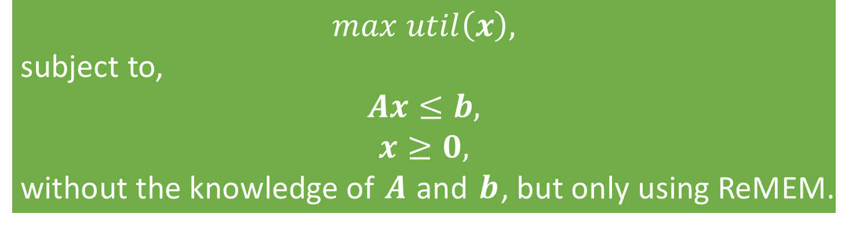
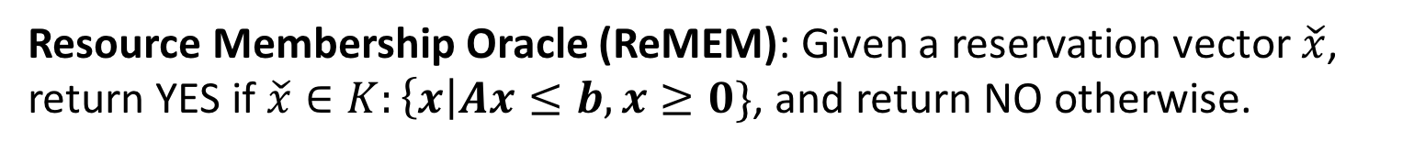
Optimization via Membership Oracle: Problem Definition
Resource Membership Oracle (ReMEM): Given a reservation vector $\check{x}$, return YES if $\check{x}∈K:\left\{x\right|Ax≤b, x≥0\}$, and return NO otherwise.
$$max util\left(x\right),$$
subject to,
$$Ax≤b,$$
$$x≥0,$$
without the knowledge of $A$ and $b$, but only using ReMEM.

Slide 16
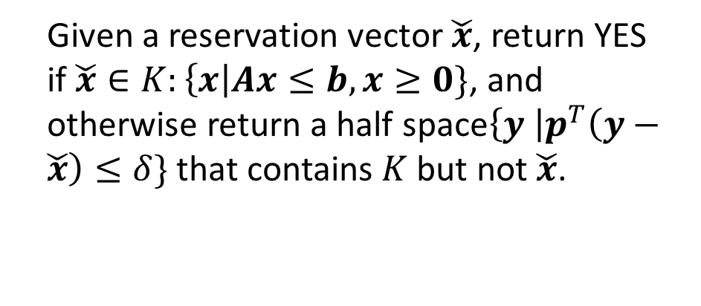
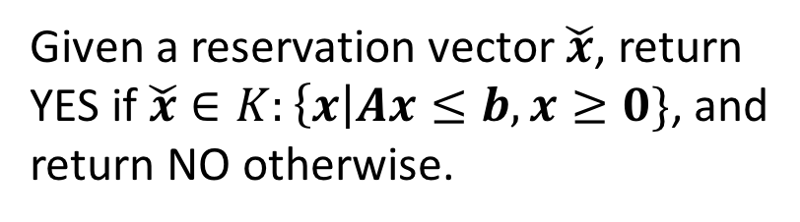
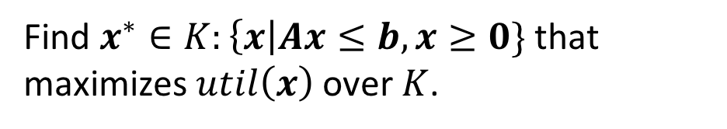
Optimization via Membership Oracle: Roadmap
Resource
Optimization Oracle
Find $x^{∗}∈K:\left\{x\right|Ax≤b, x≥0\}$ that maximizes $util\left(x\right)$ over $K$.
Reservation
Vector
Yes /
Separation Half Space
Given a reservation vector $\check{x}$, return YES if $\check{x}∈K:\left\{x\right|Ax≤b, x≥0\}$, and otherwise return a half space$\left\{y \right|p^{T}\left(y−\check{x}\right)≤δ\}$ that contains $K$ but not $\check{x}$.
Resource
Separation Oracle
Reservation
Vector
Yes / No
Given a reservation vector $\check{x}$, return YES if $\check{x}∈K:\left\{x\right|Ax≤b, x≥0\}$, and return NO otherwise.
Resource
Membership Oracle

Slide 17
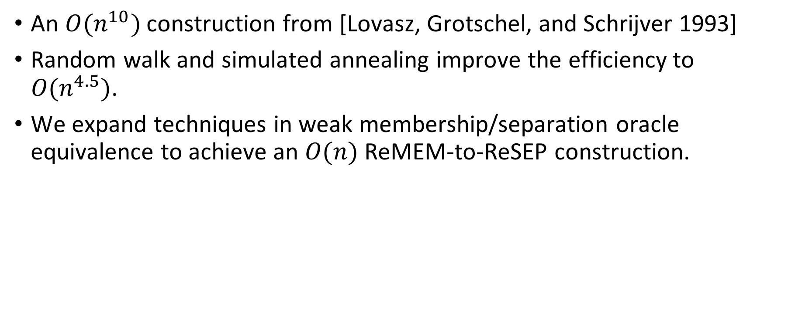
From ReMEM to ReSEP
An $O(n^{10})$ construction from [Lovasz, Grotschel, and Schrijver 1993]
Random walk and simulated annealing improve the efficiency to $O(n^{4.5})$.
We expand techniques in weak membership/separation oracle equivalence to achieve an $O(n)$ ReMEM-to-ReSEP construction.

Slide 18

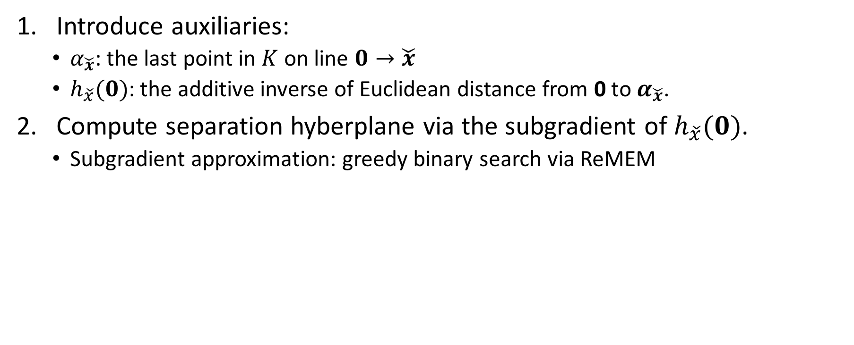
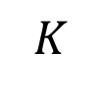
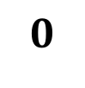

From ReMEM to ReSEP: Basic Idea
Introduce auxiliaries:
$α_{\check{x}}$: the last point in $K$ on line $0→\check{x}$
$h_{\check{x}}(0)$: the additive inverse of Euclidean distance from 0 to $α_{\check{x}}$.
Compute separation hyberplane via the subgradient of $h_{\check{x}}(0)$.
Subgradient approximation: greedy binary search via ReMEM
$$\check{x}$$
$$K$$
$$α_{\check{x}}$$
$$0$$

Slide 19
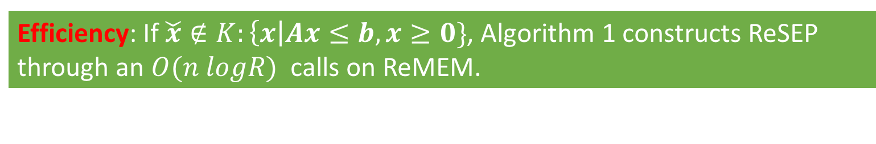
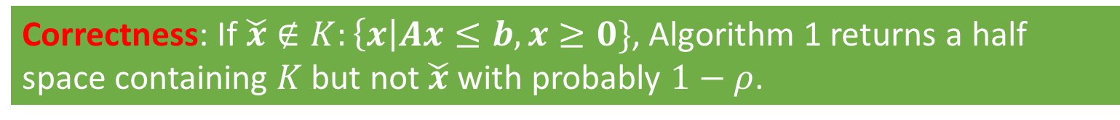
From ReMEM to ReSEP: Analysis
Correctness: If $\check{x}∉K:\left\{x\right|Ax≤b, x≥0\}$, Algorithm 1 returns a half space containing $K$ but not $\check{x}$ with probably $1−ρ$.
Efficiency: If $\check{x}∉K:\left\{x\right|Ax≤b, x≥0\}$, Algorithm 1 constructs ReSEP through an $O(n logR)$ calls on ReMEM.

Slide 20

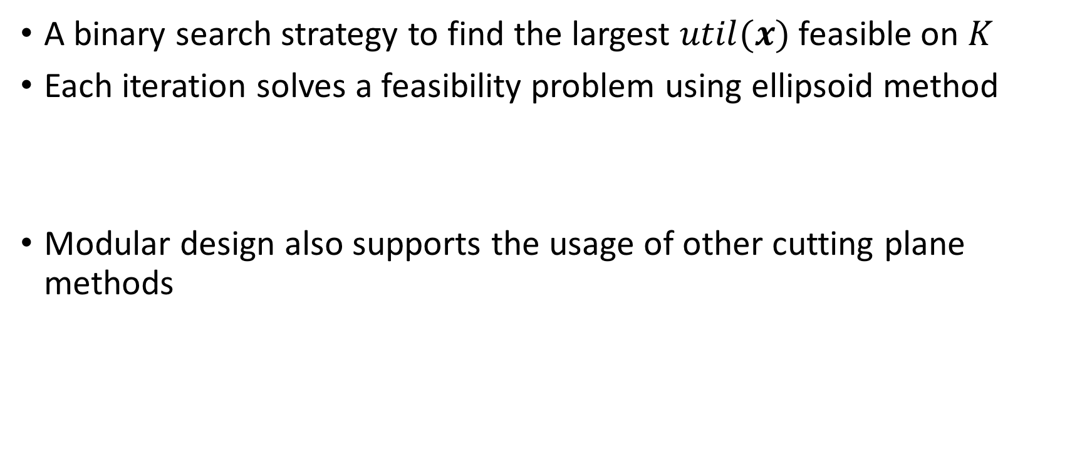
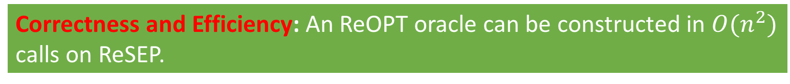
From ReSEP to ReOPT
A binary search strategy to find the largest $util(x)$ feasible on $K$
Each iteration solves a feasibility problem using ellipsoid method
Modular design also supports the usage of other cutting plane methods
$$util\left(x\right)≥u_{next},$$
$$Ax≤b,$$
$$x≥0,$$
Correctness and Efficiency: An ReOPT oracle can be constructed in $O(n^{2})$ calls on ReSEP.

Slide 21
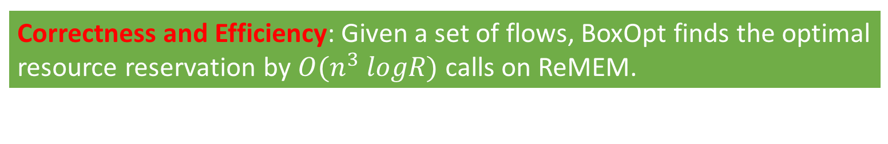
Putting Things Together
ARO Controller
Resource
Optimization Oracle
Reservation
Vector
Inferred
Search Space
Reservation
Vector
Yes /
Separation Half Space
ARO Scout
Resource
Separation Oracle
Reservation Vector
Success / Failure
Reservation
Vector
Yes / No
Network Resource Reservation Module
Resource
Membership Oracle
Correctness and Efficiency: Given a set of flows, BoxOpt finds the optimal resource reservation by $O(n^{3} logR)$ calls on ReMEM.

Slide 22
Performance Evaluation
Topology: a large science federation network (LHCONE) with 62 institutes and hundreds of network elements (i.e., switches/routers)
Traffic: a 48-hour flow reservation trace in LHCONE with a total of 716 reservation requests
Number of flows in each request ranges from 1 to 7.
Users' objective function: maximal throughput and maximal weighted throughput

Slide 23
Efficiency and Scalability of BoxOpt
Communication latency of BoxOpt with different sizes of request.
CDF of the communication latency of BoxOpt.
For 95% of requests, BoxOpt learns the optimal resource reservation within 13 seconds (assuming the user is in NYC and the network is in LA)

Slide 24
Efficiency Breakdown: from ReMEM to ReSEP
Number of ReMEM invocations with different sizes of request.
CDF of the number of ReMEM invocations.
In BoxOpt, 95% of ReSEP can be constructed within less than 30k ReMEM calls.

Slide 25
Summary
Good news
BoxOpt: a learning system that automatically learns the optimal resource reservations without exchanging any private information between the network and the user.
Bad news
13s with a proxy on the network side and 30k ReMEM calls, are we happy?

Slide 26
Roadmap
How (in)efficient current network interfaces can be?
BoxOpt: optimizing in the dark [AAAI-19] [TON-21]
How can we redesign network interfaces to let applications better utilize network resources w/o such repeatedly try-and-error?
Mercator: multi-domain resource orchestration using linear-inequality abstraction [SC-18] [JSAC-19]

Slide 27
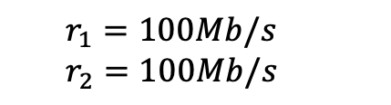
Strawman: Application Layer Traffic Optimization Protocol
RFC 7285 since 2014
Basic idea: use a one-big-switch abstraction to provide applications end-to-end network information
Limitation: cannot reveal the shared bottleneck resources between analytics tasks.
Resource information provided by one-big-switch abstraction
s₁
d₁
s₂
d₂
$$r_{1}=100Mb/s$$
$$r_{2}=100Mb/s$$

Slide 28
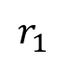
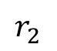
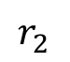
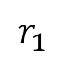
One-Big-Switch Abstraction: Ambiguity
$$r_{1}$$
No shared resources
Shared resources
100
$$r_{2}$$
100
Feasible region
$$r_{1}$$
100
$$r_{2}$$
100
Feasible region

Slide 29
Mercator Resource Abstraction
Basic idea: Use linear inequalities to provide a compact representation of multi-domain network available bandwidth.
$$x_{1}$$
100
$$x_{2}$$
100
Geometrically, resource abstraction represents the bandwidth feasible region of network for providing bandwidths to this set of circuits.
Redundant inequalities are removed via a polynomial-time, optimal algorithm.
Notes:
Our idea: on-demand, partianl-instantiation

Slide 30
Can Resource Abstraction Handle Non-Unicast Circuits?
Basic idea: introduce auxiliary variables and additional equations.
Multicast circuit

Slide 31
Resource Abstraction: Multi-Path Circuit

Slide 32
Resource Abstraction: Accuracy
Resource abstraction provides a compact, accurate representation of multi-domain network available bandwidth.
A fair optimal solution: $x_{1}=10, x_{2}=5, x_{3}=5$
Step 5
Notes:
Our idea: on-demand, partianl-instantiation

Slide 33
Resource Abstraction: Privacy Concern
Resource abstraction represents the bandwidth feasible region of network for providing bandwidths to this set of circuits.
Such regions are also private information.
Aggregator becomes single point of failure.
Step 5
Notes:
Our idea: on-demand, partianl-instantiation

Slide 34
Mercator: Key Components
Resource abstraction: Use linear inequalities to provide a compact representation of multi-domain network available bandwidth.
Resource abstraction obfuscating: Merge the resource abstraction of multiple domains without revealing the abstraction of individual domain.
Notes:
Our idea: on-demand, partianl-instantiation

Slide 35
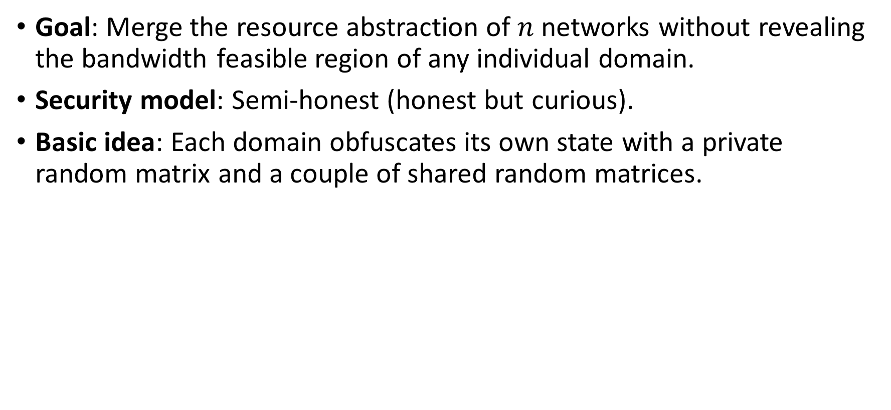
Resource Abstraction Obfuscating Protocol
Goal: Merge the resource abstraction of $n$ networks without revealing the bandwidth feasible region of any individual domain.
Security model: Semi-honest (honest but curious).
Basic idea: Each domain obfuscates its own state with a private random matrix and a couple of shared random matrices.
AS₂

Slide 36
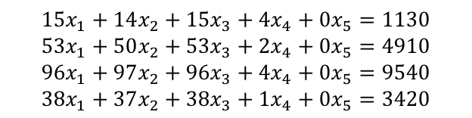
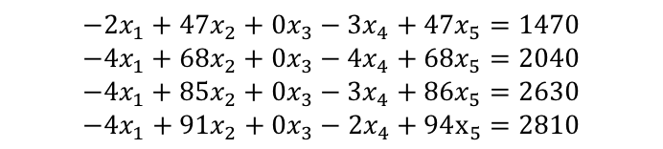

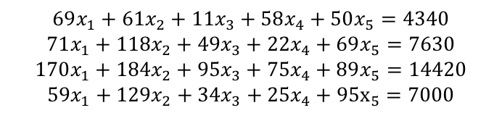
Resource Abstraction Obfuscating Protocol: Example
$$69x_{1}+61x_{2}+11x_{3}+58x_{4}+50x_{5}=4340$$
$$71x_{1}+118x_{2}+49x_{3}+22x_{4}+69x_{5}=7630$$
$$170x_{1}+184x_{2}+95x_{3}+75x_{4}+89x_{5}=14420$$
$$59x_{1}+129x_{2}+34x_{3}+25x_{4}+95x_{5}=7000$$
Aggregator
Maximizing $x_{1}+x_{2}$ subject to either feasible region would get the optimal solution $x_{1}=x_{2}=30$.
Mercator Server 1
Mercator Server 2
Mercator Server 3
$$15x_{1}+14x_{2}+15x_{3}+4x_{4}+0x_{5}=1130$$
$$53x_{1}+50x_{2}+53x_{3}+2x_{4}+0x_{5}=4910$$
$$96x_{1}+97x_{2}+96x_{3}+4x_{4}+0x_{5}=9540$$
$$38x_{1}+37x_{2}+38x_{3}+1x_{4}+0x_{5}=3420$$
$$−2x_{1}+47x_{2}+0x_{3}−3x_{4}+47x_{5}=1470$$
$$−4x_{1}+68x_{2}+0x_{3}−4x_{4}+68x_{5}=2040$$
$$−4x_{1}+85x_{2}+0x_{3}−3x_{4}+86x_{5}=2630$$
$$−4x_{1}+91x_{2}+0x_{3}−2x_{4}+94x_{5}=2810$$
$$56x_{1}+0x_{2}−4x_{3}+57x_{4}+3x_{5}=1740$$
$$22x_{1}+0x_{2}−4x_{3}+24x_{4}+x_{5}=680$$
$$78x_{1}+2x_{2}−x_{3}+74x_{4}+3x_{5}=2250$$
$$25x_{1}+0x_{2}+0x_{3}+25x_{4}+0x_{5}=770$$
$$Π_{1}\left(F_{1}\right):\left\{x_{1}+x_{2}≤100\right\}$$
$$Π_{2}\left(F_{2}\right):{\{x}_{1}≤30\}$$
$$Π_{3}\left(F_{3}\right):{\{x}_{2}≤30\}$$

Slide 37
Resource Abstraction: Scalability Concern
Issue: Computing and collecting resource abstraction for each request from scratch is expensive, and therefore may not be scalable.
Bottleneck: communication between Mercator domain servers and aggregator
Step 5

Slide 38
Mercator: Key Components
Resource abstraction: Use linear inequalities to provide a compact representation of multi-domain network available bandwidth.
Resource abstraction obfuscating: Merge the resource abstraction of multiple domains without revealing the abstraction of individual domain.
Super-set projection: Improve the system scalability via pre-computation and projection.
Notes:
Our idea: on-demand, partianl-instantiation

Slide 39
Mercator: Putting Pieces Together
Goal: Provide fine-grained, global network resource information, to optimize large-scale, multi-domain data transfers.
User submits a resource discovery request of a set of circuits to a logically centralized aggregator;
Aggregator decomposes the request and forwards it to Mercator domain servers at networks;
Mercator servers compute, obfuscate and return resource abstraction to aggregator
Aggregator composites the information and returns to user;
User computes and sends reservation requests to reservation systems at networks.
Step 5
Notes:
Our idea: on-demand, partianl-instantiation

Slide 40
Benefits of Mercator
Objective: max-min fairness
Objective: total throughput
An average of 2x improvement of fairness
An average of 15% improvement of throughput

Slide 41
Benefits of Mercator
Request failure ratio of probe-requests-based systems
Resource discovery latency
An average of 100x improvement of resource discovery latency
Probe-requests-based systems have an average of 73% request failure ratio.

Slide 42
Efficiency of Resource Abstraction Obfuscating
Obfuscating latency
Obfuscated data transmission
The resource abstraction obfuscating protocol scales to up to 200 member network.

Slide 43
Summary
Mercator, a multi-domain network resource discovery System, to provide fine-grained, global network resource information, to optimize large-scale, multi-domain data transfers.
Pre-production deployed at CMS-US sites to orchestrate 100Gbps workflows
Question
Mercator assumes routes are given. What if the given routes have poor performance?
Application can try to control intradomain routes using segment routing, SDN, etc.
What about interdomain routes?

Slide 44
Roadmap
How (in)efficient the current network interfaces can be?
BoxOpt: optimizing in the dark [AAAI-19] [TON-21]
How can we redesign network resource interfaces to let applications better utilize network resources w/o such repeatedly try-and-error?
Mercator: multi-domain resource orchestration using linear-inequality abstraction [SC-18] [JSAC-19]
How can we redesign interdomain routing interfaces to let applications flexibly control interdomain routes?
SDI: software-defined internetworking [INFOCOM-20] [INFOCOM-21]

Slide 45
Background: What is Interdomain Routing
Determine routes for source-destination pairs that span multiple ASes
Ideally, allow policy-routing, flexible traffic engineering and etc.
De facto interdomain routing protocol: Border Gateway Protocol (BGP)
BGP in a nutshell: Each AS makes and executes its own policy to select routes and export the selected routes in terms of path vectors (i.e., AS path), to its neighbor ASes
BGP can implement policy-routing, but not other use cases such as flexible traffic engineering
[E, G, I, D]
[E, F, D]
[E, H, D]
[A, B, E, G, I, D]
[A, C, E, G, I, D]
B
F
[S, A, B, E, G, I, D]
S
A
E
G
I
D
IP prefix p
C
H

Slide 46
Limitation of BGP: Lacking Mechanisms for Flexible End-to-End Interdomain Route Control
Example: Shorter AS-paths can be achieved, but S cannot select them
BGP does not provide mechanisms for S to control E's route selection
[E, G, I, D]
[E, F, D]
[E, H, D]
[A, B, E, G, I, D]
[A, C, E, G, I, D]
B
F
[S, A, B, E, G, I, D]
S
A
E
G
I
D
C
H
IP prefix p

Slide 47
Related Work to Achieve Flexible End-to-End Interdomain Route Control
BGP mechanisms (e.g., BGP FlowSpec, AS path prepending and BGP communities)
Limited control on end-to-end interdomain route due to the destination based forwarding nature and the peering model of BGP
Tunnel-based overlay (e.g., MIRO, ARROW and RCS)
Introduce data path overhead such as tunneling processing
SDX
Use-announcement inconsistency may cause loop

Slide 48
Software-Defined Internetworking
A systematic formulation to extend intradomain SDN to generic interdomain SDN to support flexible, end-to-end interdomain route control
Conceptually program every single packet end-to-end in an interdomain network
Save users from the trouble of configuring and reasoning low-level details of interdomain routing (e.g., AS-path prepending, offline negotiation with different ASes and tunnel management)

Slide 49
Control Model: Abstract AS as Virtual Switch
Single domain SDN is very well understood, SDI aims to achieve similar things in interdomain setting
Each AS abstracted as a virtual switch with a pipeline of match-action tables and path-ports (i.e., AS paths)
Each AS becomes an SDI-net
packet
Port 1
[A, B, D]
packet
Port 1
Match
Action
Match
Action
Port 2
[B, D]
Port 2
Pipeline of
match-action tables
Flexible forwarding
S
A
B
D
S
D
B
A
Single domain SDN
Interdomain Network
Notes:
TODO: One more link between A and B
There's a set of ports for every prefix
Parallel figures
===
Contritbuion 1
Single domain sdn is very well understood, /accepted
We want to achieve similar things in interdomain setting
In particular
LHS: a simple switch topology
RHS: interdomain netowork, with simple switches in each network
Every as becomse fleixble as sinlge domain SDN switch (e.g., pipeline, multi-port, LB, )

Slide 50
Control Model: Control SDI Network
A client connects to SDI-nets to control paths in interdomain network
A client may select to control a subset of SDI-nets to simplify management and business arrangements
B
E
F
B
G
I
S
A
D
F
H
T
S
A
E
D
C
H
G
C
Notes:
TODO: Each switch called an SDI net
Sure m
ultipel paths, go to same dst, etc.
No payment here client: control plaen connection to every single swtich, or a subset of virtual switches call it SDI-net (comment: they can control a subset of them, , simplify management/business, arrange business relationship)

Slide 51
SDI vs. SDN: Key Difference
Dynamic and dependent path-ports in SDI-nets
Upstream path-ports depend on downstream path-ports
Example: When E selects [E, F, D] and does not export to B, A's path-port would become [A, C, E, F, D]
[E, G, I, D]
[E, G, I, D]
[E, F, D]
[E, F, D]
[E, H, D]
[A, B, E, G, I, D]
[E, H, D]
[A, C, E, F, D]
[A, C, E, G, I, D]
F
B
E
Path selections at SDI-nets must be consistent
B
G
I
S
A
D
F
H
T
S
A
E
D
C
H
G
C
Notes:
Major difference is not only dynamc
Make analogy: sdn port can also be up/down dynamic, but every virtual port here is a path, and a property of the port, so they are coupled.
=============
a client cannot control E to select [E, F, D] and A to select [A, B, E, F, D] simultaneously

Slide 52
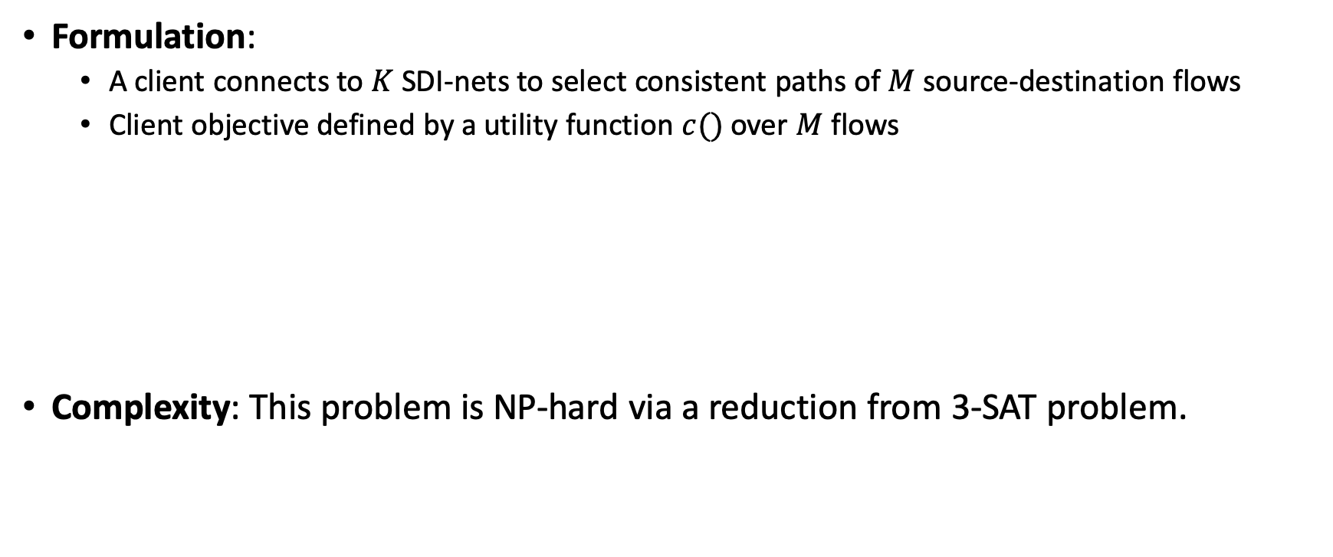
Client SDI Control Optimization Problem
Formulation:
A client connects to $K$ SDI-nets to select consistent paths of $M$ source-destination flows
Client objective defined by a utility function $c()$over $M$ flows
Complexity: This problem is NP-hard via a reduction from 3-SAT problem.
Notes:
TODO: add an outline
Remove comma,
Introduction
SDI network control model
Client SDI Control Optimization

Slide 53
First Cut: A Naïve Enumeration Algorithm
Basic idea: use Yen's algorithm [1] to iteratively compute the i-th optimal path, and test path consistency on the shadow control plane
Issue 1: testing path consistency takes time
Issue 2: enumerating paths has an exponential complexity in the worst case
[1] Yen, Jin Y. "Finding the k shortest loopless paths in a network." management Science 17, no. 11 (1971): 712-716.

Slide 54
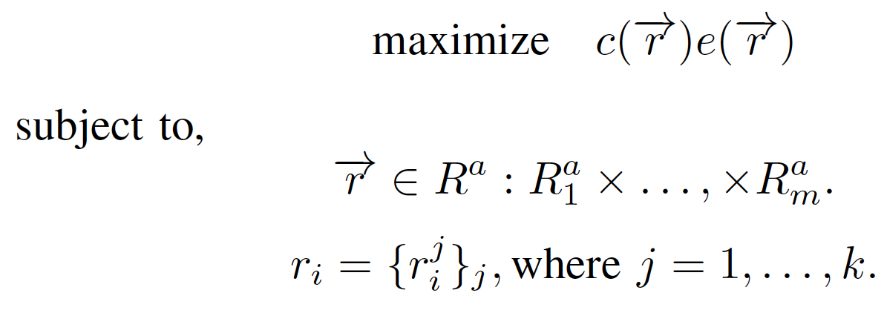
A Blackbox Optimization Reformulation: Lift Path Consistency from Constraint to Objective Function
Binary variable to indicate path consistency
Why blackbox optimization? Suitable for optimization problem whose objective function is expensive to evaluate, e.g., testing the consistency of a path in SDI
Basic idea: uses the prior belief to direct the search, and uses the posterior to update the belief
Issue: works well in continuous solution space, but not in combinatorial, discrete solution spaces, such as client SDI control optimization

Slide 55
Customize Blackbox Optimization for Client SDI Control Optimization
Key idea 1: one path inconsistency can prune a large search space
v₁
v₂
v_{i}
v_{i+1}
v_{K}
…
…
Inconsistency happens between v_{i+1} and v_{i}, i.e., v_{i} does not export a selected path to v_{i+1}
Any path containing v_{i+1}'s selected path is not a consistent path

Slide 56
Customize Blackbox Optimization for Client SDI Control Optimization
Key idea 2: one consistent path can avoid many repeated tests in future search
v₁
v₂
v_{i}
v_{i+1}
v_{K}
…
…
When another SDI-net tries to use v_{x}'s selected path (x=1, …, i+1), no need to check consistency starting from v₁.
v₁ , …, v_{i+1} provide a consistent path

Slide 57
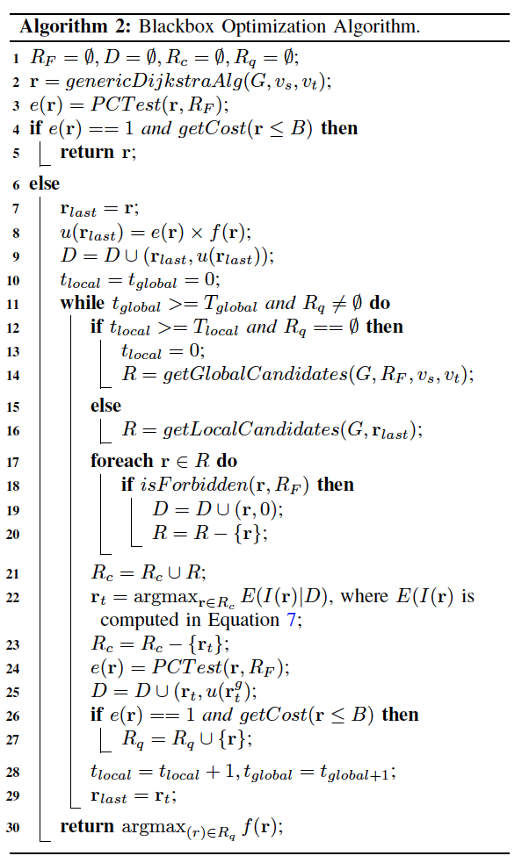
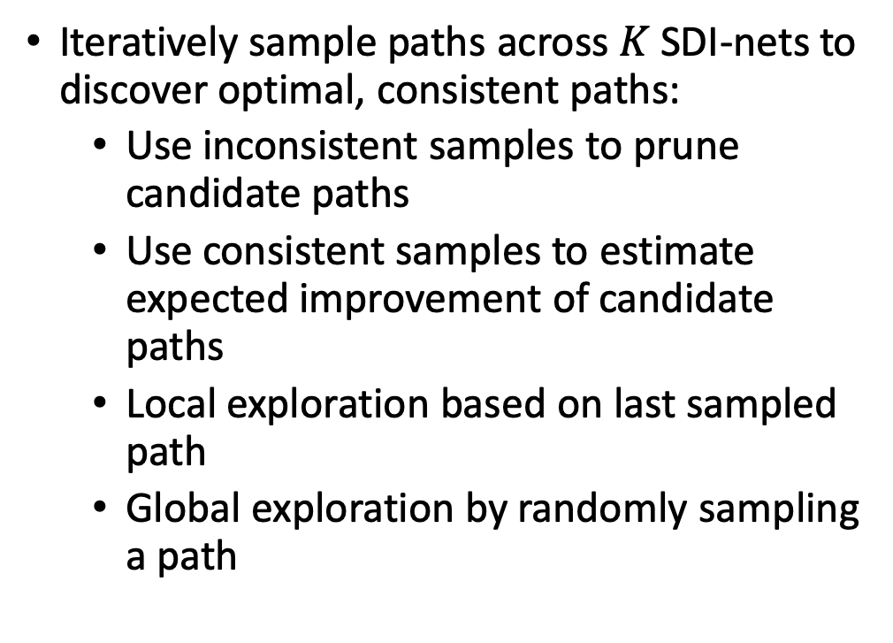
Put Two Ideas into BO to Improve Search Efficiency
Iteratively sample paths across $K$ SDI-nets to discover optimal, consistent paths:
Use inconsistent samples to prune candidate paths
Use consistent samples to estimate expected improvement of candidate paths
Local exploration based on last sampled path
Global exploration by randomly sampling a path
Notes:
TODO: do some analysis, enumerate every control points, every route, …

Slide 58
Performance Evaluation: Settings
Topology: CAIDA Internet topology dataset with 63361 ASes and 320978 AS-level links.
AS export policies: (1) C/P relationship, (2) blacklist ASes, (3) forbidden segments.
Client objective: find shortest AS path for top 2000 AS-pairs in terms of traffic volume, based on CAIDA Internet traffic dataset
Comparison: SDI blackbox optimization vs. naïve enumeration with Yen's algorithm
Notes:
Added earlier

Slide 59
Results: Efficacy and Efficiency of SDI Control
In all experiments, the SDI optimization algorithm finds the optimal policy-compliant shortest AS path
In 95% cases, it finds the optimal solution by sampling no more than 35 paths.

Slide 60
Summary
SDI: extending intradomain SDN to generic interdomain SDN
Stability of allowing flexible interdomain control?
A solvability digraph theory to reasonable about interdomain routing solvability

Slide 61
What We Have Accomplished
(In)efficiency of the current network reservation interface
Optimization via oracle transformation
Redesign of network resource interfaces:
Network resource information exposure using linear-inequality abstraction
Redesign of interdomain routing interfaces:
Software-defined internetworking using programmable interfaces and blackbox optimization

Slide 62
Many Open Questions Awaits for Us
Unified, application-network co-programming
Fine-grained, multi-resource, multi-domain orchestration
High service availability
…
Thank you!
Please drop me an email (xiangq27@gmail.com / qiaoxiang@xmu.edu.cn) if you are interested.

Slide 63
Backup Slides

Slide 64
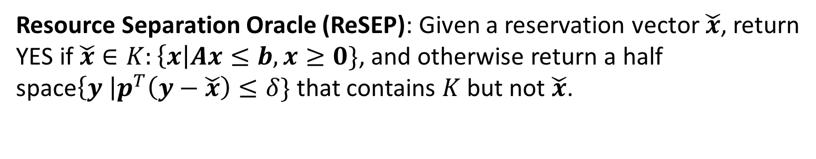
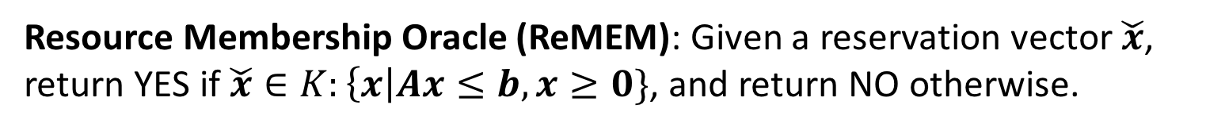
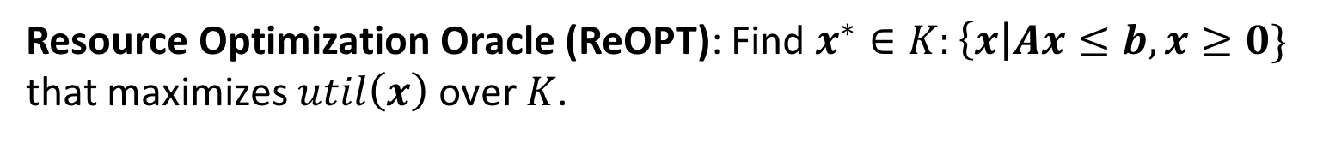
Optimization via Membership Oracle: Basic Idea
Other than membership oracles, there are other basic oracles in optimization theory.
Resource Membership Oracle (ReMEM): Given a reservation vector $\check{x}$, return YES if $\check{x}∈K:\left\{x\right|Ax≤b, x≥0\}$, and return NO otherwise.
Resource Separation Oracle (ReSEP): Given a reservation vector $\check{x}$, return YES if $\check{x}∈K:\left\{x\right|Ax≤b, x≥0\}$, and otherwise return a half space$\left\{y \right|p^{T}\left(y−\check{x}\right)≤δ\}$ that contains $K$ but not $\check{x}$.
Resource Optimization Oracle (ReOPT): Find $x^{∗}∈K:\left\{x\right|Ax≤b, x≥0\}$ that maximizes $util\left(x\right)$ over $K$.
Different basic oracles in optimization theories have equivalence and polar relationships.

Slide 65
Correctness of BoxOpt
In all 716 requests, BoxOpt computes the same optimal resource reservations as computed by CPLEX, i.e., BoxOpt achieves a 100% correctness ratio.

Slide 66
Efficiency Breakdown: from ReSEP to ReOPT
Number of ReSEP invocations with different sizes of request.
CDF of the number of ReSEP invocations.
In BoxOpt, 95% of ReOPT can be constructed within less than 200 ReSEP calls.

Slide 67
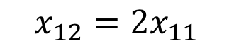
Resource Abstraction: Weight-Cost Multi-Path Circuit
Network M₁: Split the traffic of (S₁, e₁), (S₁, e₂) in a ratio of 1:2
$$x_{12}=2x_{11}$$

Slide 68
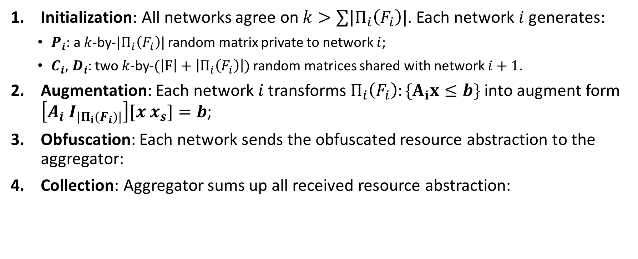
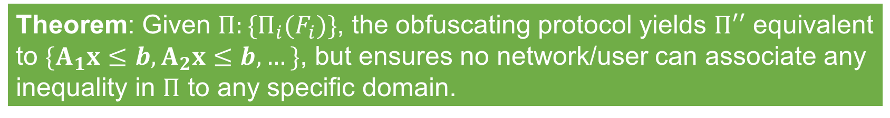

Resource Abstraction Obfuscating Protocol: Specification
Initialization: All networks agree on $k>∑|Π_{i}\left(F_{i}\right)|$. Each network $i$ generates:
$P_{i}$: a $k$-by-$|Π_{i}\left(F_{i}\right)|$ random matrix private to network $i$;
$C_{i}$, $D_{i}$: two $k$-by-$(\left|F\right|+\left|Π_{i}\left(F_{i}\right)\right|)$ random matrices shared with network $i+1$.
Augmentation: Each network $i$ transforms $Π_{i}\left(F_{i}\right):\{A_{i}x≤b\}$into augment form $\left[A_{i} I_{|Π_{i}(F_{i})|}\right][x x_{s}]=b$;
Obfuscation: Each network sends the obfuscated resource abstraction to the aggregator:
Collection: Aggregator sums up all received resource abstraction:
$$\left[P_{i}\left[A_{i} I_{|Π_{i}(F_{i})|}\right] −C_{i−1}+C_{i}\right]\left[x x_{s}\right]=P_{i}b_{i}−D_{i−1}+D_{i}$$
$$Π^{′′}:\left[{∑P}_{i}A_{i} P_{1}…P_{N}\right]\left[x x_{s}\right]={∑P}_{i}b_{i}$$
Theorem: Given $Π:\{Π_{i}(F_{i})\}$, the obfuscating protocol yields $Π′′$ equivalent to $\{A_{1}x≤b,A_{2}x≤b, …\}$, but ensures no network/user can associate any inequality in $Π$ to any specific domain.

Slide 69

Resource Abstraction Super-Set Projection
Basic idea: Proactively discover the resource information for a set of circuits between every pair of source and destination networks, and project the collected information to derive the responses to user’s requests.
Example: Aggregator proactively discovers the resource abstraction for circuits between 3 member networks.
Aggregator
What is the resource information of two circuits: one from M₁ to M₂, and one from M₂ to M₃.
$$x_{12}≤60$$
$$x_{23}≤80$$

Slide 70
Performance Evaluation
Topology: LHCONE: a science federation network of 62 member networks
Intradomain topology: randomly chosen from Topology Zoo
Traffic: 48-hour CMS trace data
Metrics: throughput, fairness, latency, scalability, …

Slide 71
Efficiency of Super-Set Projection
Scalability via super-set projection
Update latency
Super-set projection decreases the average resource discovery latency by around 2 times, and scales to up to 200 member network.

Slide 72
Select Consistent Paths
Issue: when a client selects a different path-port at downstream, path ports at upstream may change, causing churns and disruption
Solution: (1) Three-layer design of SDI-net, (2) Two-phase-commit path selection
Phase 1: select paths and test consistency in shadow CP
Shadow
control plane
(RIB / FIB in transition)
Shadow
control plane
(RIB / FIB in transition
Interdomain routing protocol
Control plane (RIB)
Control plane (RIB)
Phase 2: commit consistent paths to data plane
Interdomain routing protocol
Data plane (FIB)
Data plane (FIB)
data link
Notes:
TODO: use path for consistency Previous slide is understanding, nto challenge
Here we talk about it comets issue, i.e., client control cuase issue like churns, solution is then 3-layer deisng redraw the figure as a design, not an example: data plane (FIB), control plane (RIB), virtual control plane/transaction layer (RIB in transition)

Slide 73
Results: Search Efficiency Improvement Over Naïve Enumeration
Reduced number of samples: Compared to SDI blackbox optimization, the additional number of samples required by naïve enumeration to find the optimal path
For 50% of the experiment cases, blackbox optimization can find the optimal path using at least 15 samples less than the naïve enumeration
Reduced number of samples

Slide 74

Background
Today's premier science experiments rely on finely-tuned workflows that coordinate geographically distributed resources.
Large Hadron Collider
Linac Coherent Light Source
Square Kilometre Array
Figure sources: phys.org, extremetech.com

Slide 75
Example: Compact Muon Solenoid (CMS) Experiment in Large Hadron Collider (LHC)
Large raw datasets from LHC at the Tier-0 site
RAW Data: tens of PB per year
RECO and AOD: multiple times of RAW data depending on analysis requirements
RECO and AOD datasets are distributed to Tier-1 sites
RECO, AOD and simulation datasets are transferred among Tier-1~3 sites for analysis.
The key to supporting these distributed resource workflows is the ability to reserve and guarantee bandwidth across multiple network domains to facilitate predictable end-to-end network connectivity.

Slide 76
Multi-domain Circuit Reservation Systems
Several multi-domain network resource reservation systems are being deployed, driven by the demand and substantial benefits of providing predictable network resources.
Example: OSCARS [1]
A network interface is provided for users to submit requests for reserving a specific amount of bandwidth, and return either success or failure.
User
Circuit set,
Bandwidth Values
Success / Failure
Reservation System
Network
[1] On-Demand Secure Circuits and Advance Reservation System: http://es.net/engineering-services/oscars/

Slide 77
Inefficiency of Reservation Systems: Example
For a set of circuits (S, D₁), (S, D₂) and (S, D₃), how much bandwidth can the user reserve?
How about now?
Member Network 1
Member Network 2
Member Network 3
40Gbps
40Gbps
100Gbps
100Gbps
10Gbps
10Gbps
100Gbps
10Gbps
10Gbps
10Gbps
S
D₁
D₂
D₃
Sequential, cut-by-half-until-reserved:
12 reserve attempts to reach
(S, D₁): 8.33 Gbps;
(S, D₂): 8.33 Gbps;
(S, D₃): 1.04 Gbps
A fair optimal solution
(S, D₁): 10 Gbps
(S, D₂): 5 Gbps
(S, D₃): 5 Gbps
The lack of visibility of network state (topology, policy and etc.) leads to substantial inefficiency of network resource reservation systems.
Notes:
Our idea: on-demand, partianl-instantiation

Slide 78
Mercator: Key Components
Resource abstraction: Use linear inequalities to provide a compact representation of multi-domain network available bandwidth.
Resource abstraction obfuscating: Merge the resource abstraction of multiple domains without revealing the abstraction of individual domain.
Super-set projection: Improve the system scalability via pre-computation and projection.
Notes:
Our idea: on-demand, partianl-instantiation

